Slide 1

LearningIT
By
DewingIT
Leadership Skill: Communication with the BDN Framework
Microsoft Architecture & Planning Framework

Slide 2

LearningIT by DewingIT Purpose
Learning Program Objective:
Leaders learn and gain experience that enables them to effectively connect, lead clearly, and communicate with people.
DewingIT Learning is a source where leaders can share ideas, experiences, and receive support from peers.
Learning Framework
Definition or Concepts
Methods, processes, and Tools
Real-world applications
Follow-up Experiences

Slide 3
Learning Objectives
Understand what a BDN is
How to use a BDN
Example outcomes from BDN

Slide 4





Joe Peppard, Ph.D.
Director, IS Research Center
Cranfield, UK
j.peppard@cranfield.ac.uk
Jeanne Ross, Ph.D.
Director & Principal Research Scientist
Center for IS Research
jross@mit.edu
Don Hiatt, Senior Consultant
IT Architecture & Planning
donhiatt@microsoft.com
Peter Weill, Ph.D.
Senior Research Scientist
Center for IS Research
pweill@mit.edu
LearningIT
By
DewingIT
Jason Ewing
Healthcare CIO
jewing@dewingit.net
Notes:
Sources for St. Luke’s application of the BDN process were coordinated through Microsoft IT Architecture & Planning services. MIT Sloan Center and Cranfield University worked with Microsoft to develop this methodology. St. Luke’s Health System has contributed to how to more effectively apply the overall technique where there is faster adoption and deeper buy-in among stakeholders through the revised approach.

Slide 5


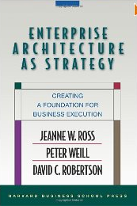
Reference Materials
Authors: John Ward, Elizabeth Daniel
Title: Benefits Management
Author: Ric Merrifield
Title: Rethink
Authors: Ross, Weill, Robertson
Title: Enterprise Architecture As Strategy
Notes:
Additional resources are available that speak to the BDN process and/or the concepts and principles incorporated into this methodology.
Authors: John Ward, Elizabeth Daniel
Title: Benefits Management - Delivering Value from IS & IT Investments
Authors: Ric Merrifield
Title: Rethink: A Business Manifesto for Cutting Costs and Boosting Innovation
Authors: Jeanne W. Ross, Peter Weill and David Robertson
Title: Enterprise Architecture As Strategy: Creating a Foundation for Business Execution

Slide 6
What is a BDN
A framework or 6 step process used to help organize our thoughts, conversations, and bring clarity to your intentions
It is fluid and can help you understand the relationships between your intents (i.e. Drivers vs objectives

Slide 7
Case for Change
Jump to solutions
Assume everyone knows what we are saying or meaning
We create rough wakes in our paths for others
Lead with out clarity

Slide 8


Benefits Management
Notes:
Often times organizations do well in planning and preparation. Where organizations encounter problems is when they fail to provide adequate planning in the right areas – the space where miracles occur.
The BDN helps planning efforts, but particularly in the areas that tend to get overlooked using traditional methodologies.
St. Luke’s Health System
http://stlukesonline.org
August 15, 2011

Slide 9
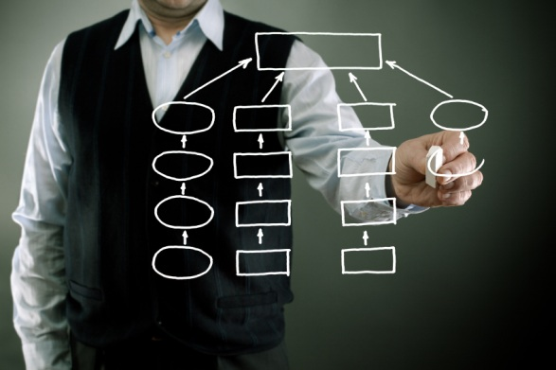
BDN Foundations
“Benefits-Driven Network”
Notes:
Business leaders look to their Enterprise Architecture resources to help them overcome these risks, but also help them identify the best avenue to achieve their strategy.
The BDN is a tool created by Enterprise Architecture practitioners to help organizations get from point A to point B without having to take the path of Sydney’s Opera House.
St. Luke’s Health System
http://stlukesonline.org
August 15, 2011

Slide 10








Benefits-Driven Network
The BDN helps to…
Organize our planning efforts
Focus on what’s most important
Understand the reasons for change
Define measureable outcomes
Identify the highest impact of change (who, when, where)
Increase objectivity in decisions and actions
Notes:
BDN Helps to…
Organize our thoughts and ideas
Focus on what’s most important to solving the problem
Clearly define the problem we are trying to solve
Determine measureable outcomes
Identify the high-risk areas where change will have the most impact
Removes emotion and personal bias through objectivity – brand-agnostic
Once completed, we end up with a high-level view of the total body of work required to achieve the goal and a road map of how to get there.

Slide 11






Six Steps to BDN
 | Drivers | What is causing the change? What is the pain forcing change?
Objectives are not solutions
 | Objectives | What is the desired future state or goal?
 | Benefits | What advantages or value will be realized? What measure will determine success?
 | Stakeholders | Who benefits most? Who is impacted most? Who is accountable to delivering the benefits?
 | Changes | What changes must occur to deliver the benefits?
 | Solutions | What solutions enable the changes?
Notes:
BDN provides decision makers with a clear, concise, and predictive view of the strategic value to the business of an investment
KEY DRIVERS – “Change Forces”
A driver is anything causing the organization to do something different tomorrow from today.
Do not change
Do not go away
Exist independent from a project or initiative
Projects represent what an organization chooses to do about the drivers.
Driver examples: Shifting markets, new product or service, problem statement, legislation or policy.
What are the things that keep us from doing what we need to do, or being who we need to be, or going where we need to go?
INVESTMENT OBJECTIVES – “Future State”
The targets to achieve by way of the project in relation to the drivers and desired changes.
Validate the scope of the project with stakeholders.
This answers the question, “Who do we want to be when we grow up?”
BENEFITS – “Business Value”
An advantage on behalf of a stakeholder or group of stakeholders.
IMPACT STAKEHOLDERS – “Business Impact”
Identifies those that will receive the benefits and be affected by the changes required.
ENABLING CHANGES – “Business Requirements”
The necessary pre-requisites for business change to happen.
SOLUTIONS – “Business Enablers”
The technologies, projects, or components required to support the changes.
St. Luke’s Health System
http://stlukesonline.org
August 15, 2011

Slide 12








Benefits Driven Network
What is forcing
us to change?
Key Driver 1
Key Driver 2
Team
Customer Dissatisfaction
Excessive internal waste of time (churn)
What are the
goals?
Objective 1
Objective 2
Objective 3
Objective 4
Active participation in customer planning
Hardwire project follow-up
Clear process owners
Roles and Responsibilities are well defined and communicated
What benefits do we
seek to achieve? How will these be measured?
Benefit 1
Benefit 2
Customer Value of the Team
Employee Job Satisfaction
Measure:. Decrease in number of planned projects by 30%
Measure: 20% Increase in employee satisfaction survey
Who is impacted?
Who benefits?
Who is responsible?
Impact Stakeholder
Impact Stakeholder
Impact Stakeholder
Customer
Team
Manager
What changes
are required?
Enabling Change 1
Enabling Change 2
Enabling Change 3
Enabling Change 4
Including team into planning
Buy-in on the vision and value
How we engage customers
How we engage internal team members
What solutions enable
the changes to occur?
Solution 1
Solution 3
Solution 4
Solution 2
Develop exhibit of cultural behaviors
Relationship development of trust
Process design and training
Develop and train on scripting

Slide 13
Benefits Driven Network
What is forcing
us to change?
Key Driver 1
Key Driver 2
Family
Lack of peace in the home
Diminishing together time
What are the
goals?
Objective 1
Objective 2
Objective 3
Improve quality time as a family.
Deepen our spiritual relationship with Jesus Christ
Improve Husband and Wife QT
What benefits do we
seek to achieve? How will these be measured?
Benefit 1
Benefit 2
Develop family bonds
Home will be a place we want to be
Measure:. Number of 1:1 and family activities
Measure: Number of arguments
Who is impacted?
Who benefits?
Who is responsible?
Impact Stakeholder
Impact Stakeholder
Impact Stakeholder
Dad
Mom
Kids
What changes
are required?
Enabling Change 1
Enabling Change 2
Enabling Change 3
Enabling Change 4
Sacrifice personal interests
Everyone’s Commitment
How we engage customers
How we engage internal team members
What solutions enable
the changes to occur?
Solution 1
Solution 3
Solution 4
Solution 2
Go to Church Weekly
1:1 and Family Activities to Connect
Mom and Dad Weekly Dates
Take parenting class

Slide 14

BDN Deliverables
Notes:
St. Luke’s Health System
http://stlukesonline.org
August 15, 2011

Slide 15
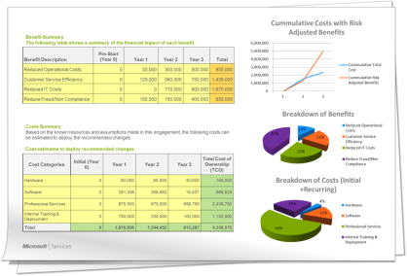
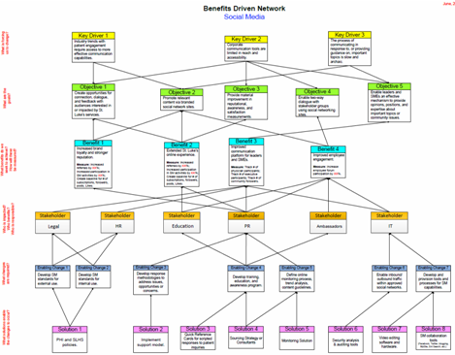
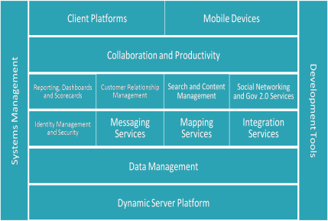
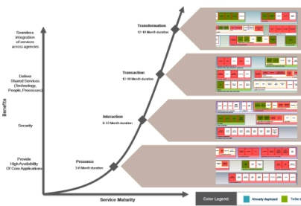
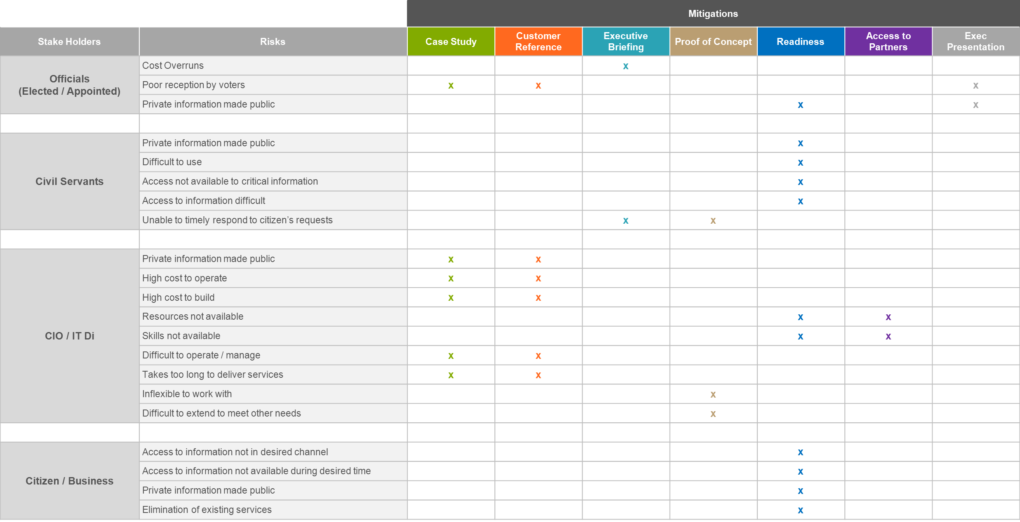
BDN Deliverables
Strategy
Planning and Communication
Road
Maps
BDN
Conversations
Notes:
The BDN Worksheet (map) feeds into several artifacts intended for decision-makers and stakeholders. The intent is to provide a visual representation of the content stemming from BDN discussions where leadership can have a simplified, one-page summary view of the costs, risks, requirements, and proposed execution plan.
Business Case
ROI determined by measures of benefits
TCO determined by enabling changes and solutions
Conceptual Architecture
Enabling Changes and Solutions determine the systems and infrastructure affected by the required changes.
Road Map
This shows the correlation of the rough project milestones and how they align to meeting the project objectives and benefits. The conceptual architecture requirements are also represented for each high-level milestone or phase of the initiative.
Risk Mitigation Plan
- The amount of change and the level of benefits realization ultimately determine what the risks are. In order to effectively manage stakeholder expectations, gain sufficient buy-in, and overcome points of resistance, the BDN emphasizes the benefits to drive stakeholder engagement activities. Although the change represents the impact level, it is the benefits that will ultimately determine the commitment level among stakeholders to support the initiative, to help make things happen, or possibly to do some of the work.
St. Luke’s Health System
http://stlukesonline.org
August 15, 2011

Slide 16
Example Outcomes
Notes:
St. Luke’s Health System
http://stlukesonline.org
August 15, 2011

Slide 18
Example Strategic Plan
Mission (Why we exist):
To provide a ministry of healing, wellness and quality inspired by our faith in Jesus Christ.
Our vision (Where we are going):
A leading Catholic healthcare system providing exceptional patient outcomes in quality, safety, access and value.
Values (How we will behave)
Integrity, Stewardship, Joy, Compassion, Excellence, Dignity
Goals
Transform the Patient Experience
Transform the Care Delivery Model
Transform the Business Model
Transform the Culture
Living our Mission and Values
Objectives
Improve Access and Availability of Care
Achieve a Delighted and Loyal Customer
Consumer Confidence in Cost and Quality
Fence in the Family
Best in Nation in Quality and Safety
Manage Data for Better Outcomes
One Integrated Delivery System
Improve Financial Performance
Improve Administrative Functions
New Saint Francis Way
Leaders Lead Transformation
Manage Human Resources
Renew our Catholic Identity
Live Out our Franciscan Mission

Slide 19
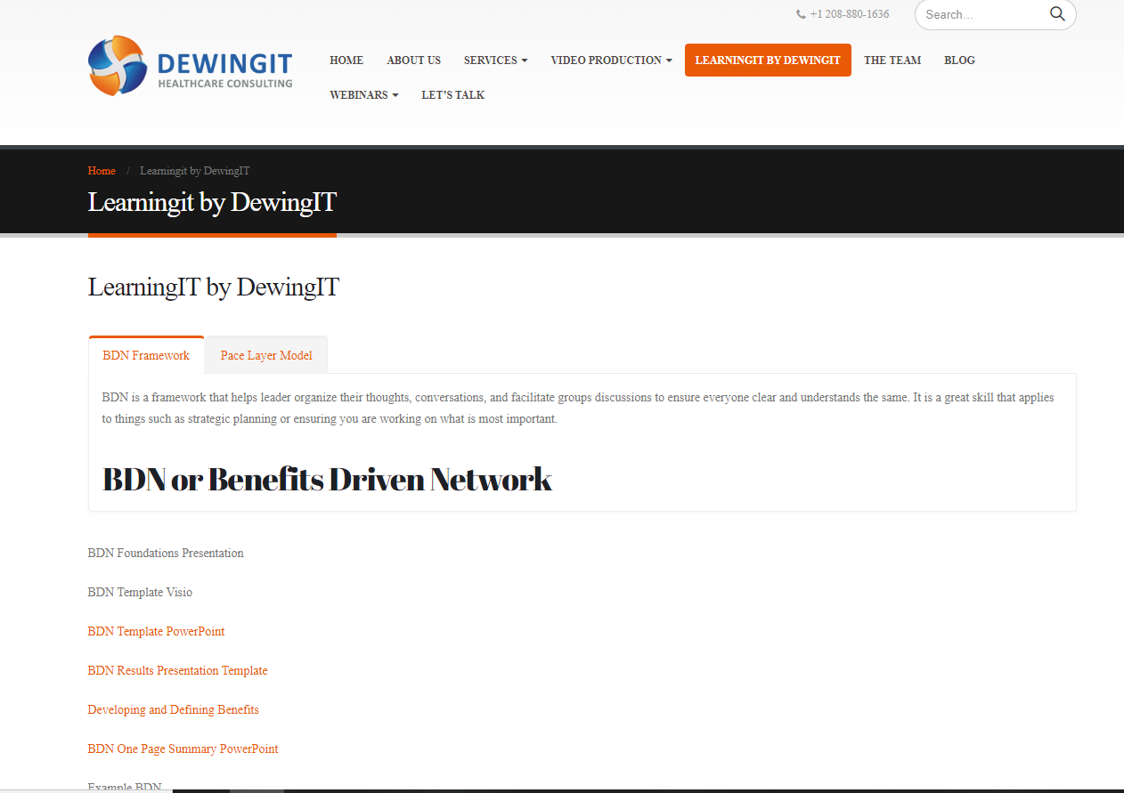
Materials
https://www.dewingit.net/learningitbydewingit/
Notes:
St. Luke’s Health System
http://stlukesonline.org
August 15, 2011

Slide 20
Feedback
What was your take-aways?
What did you like?
What would make LearningIT better?
Next Steps
Time to apply it?
Training Cadence Model?
Session 1: LearnIT
Session 1A: Share Experiences/Collaborate
Session 2: LearnIT Next Topic
Session 2A: Share Experiences/Collaborate
How Often?

Slide 21
LearningIT
By
DewingIT

